Slide 2
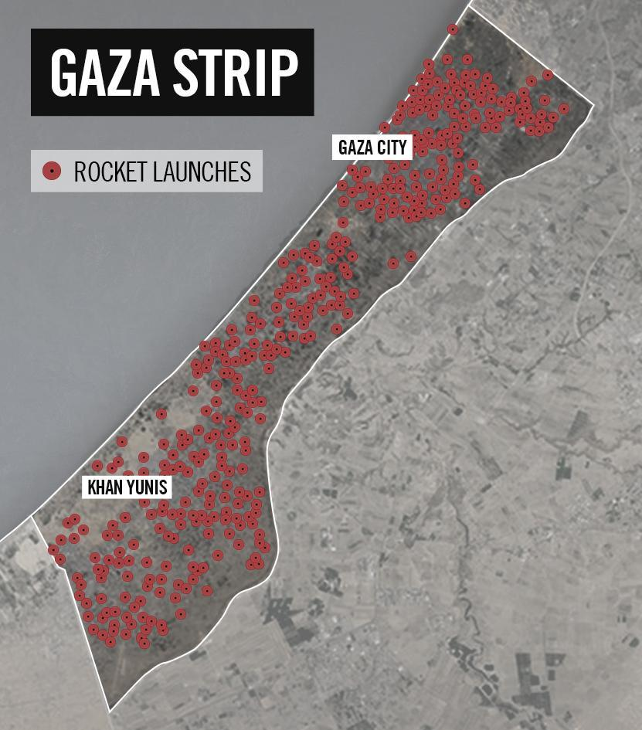
Map of Rocket Launches from Gaza at Israel
Over 3,600 rockets fired since July 8th
1,600 rockets fired from civilian areas

Slide 3
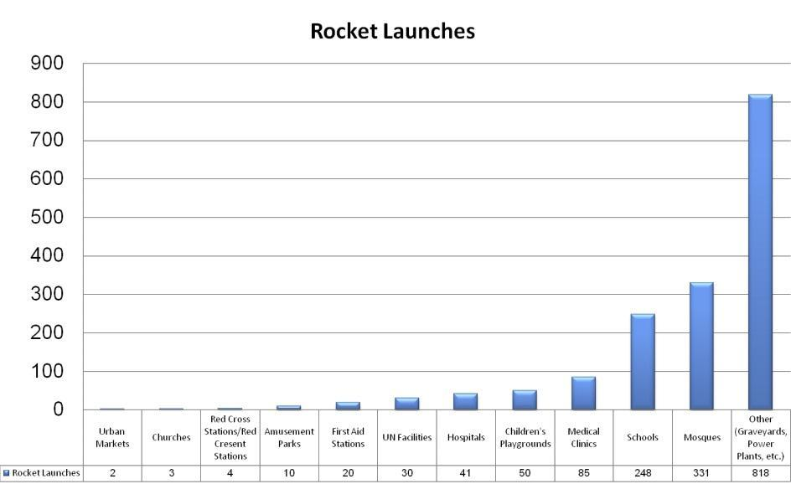
Breakdown of Rockets fired from Civilian Areas

Slide 4
Video: 12 Examples of Hamas Launching Rockets From Within Civilian Areas

Slide 5
The Most Extensive Terrorist Strongholds:
Shuja’iya, Beit Lahiya & Beit Hanoun

Slide 6
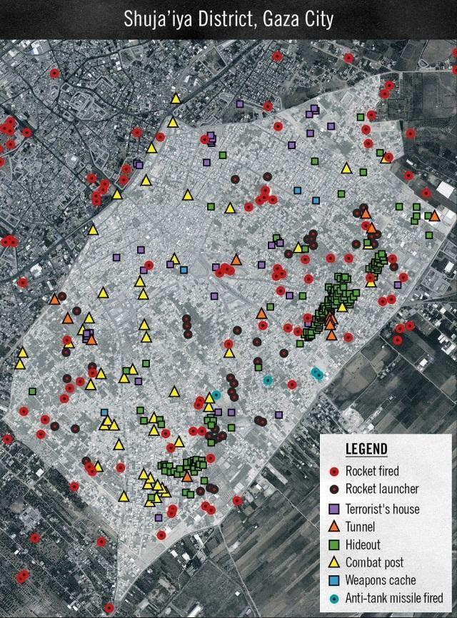
Breakdown of Hamas Terror Fortress In Shuja’iya District

Slide 7
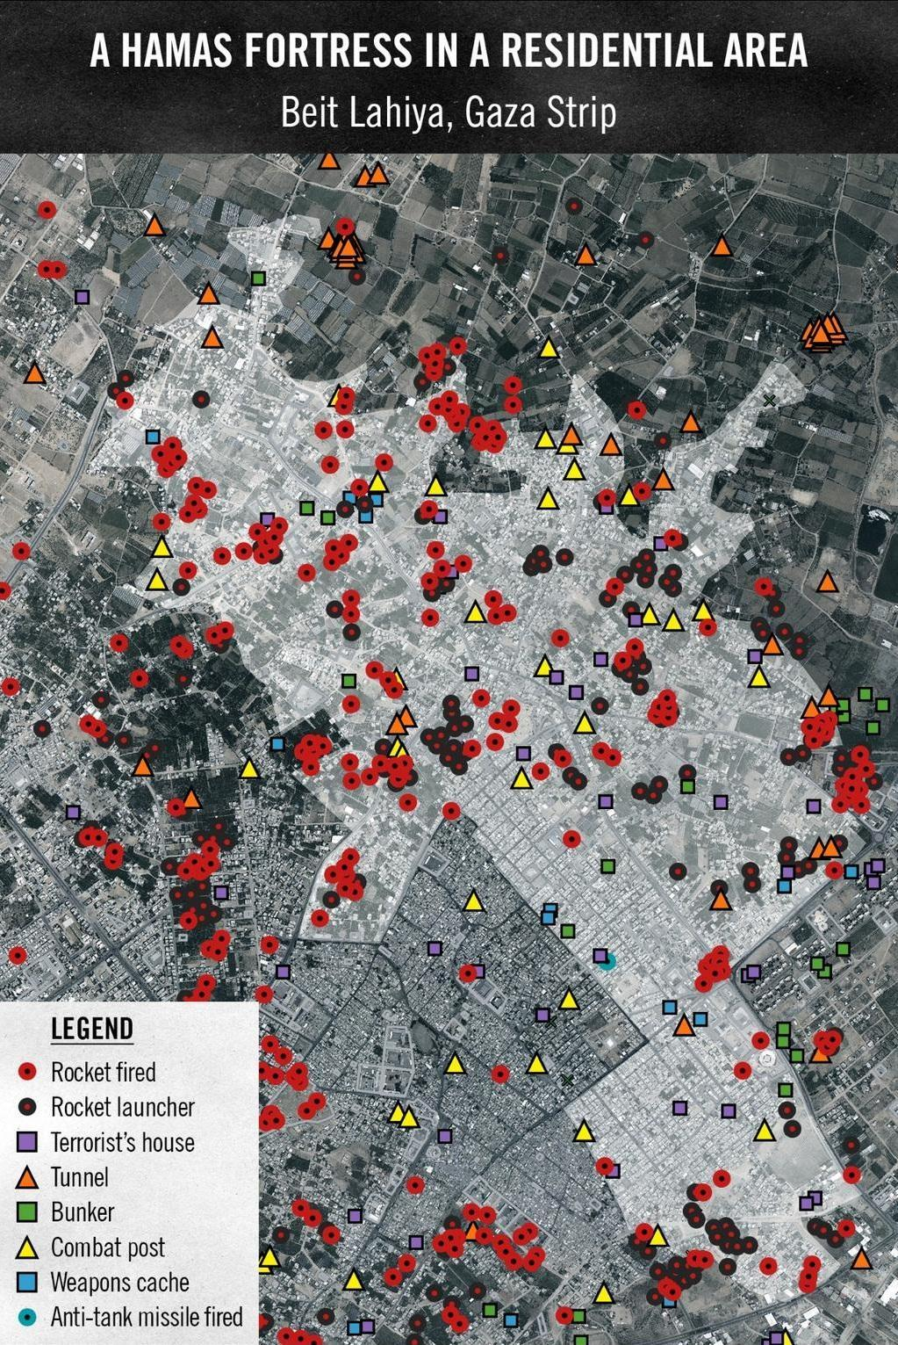
Breakdown of Hamas Terror Fortress in Beit Lahiya

Slide 8
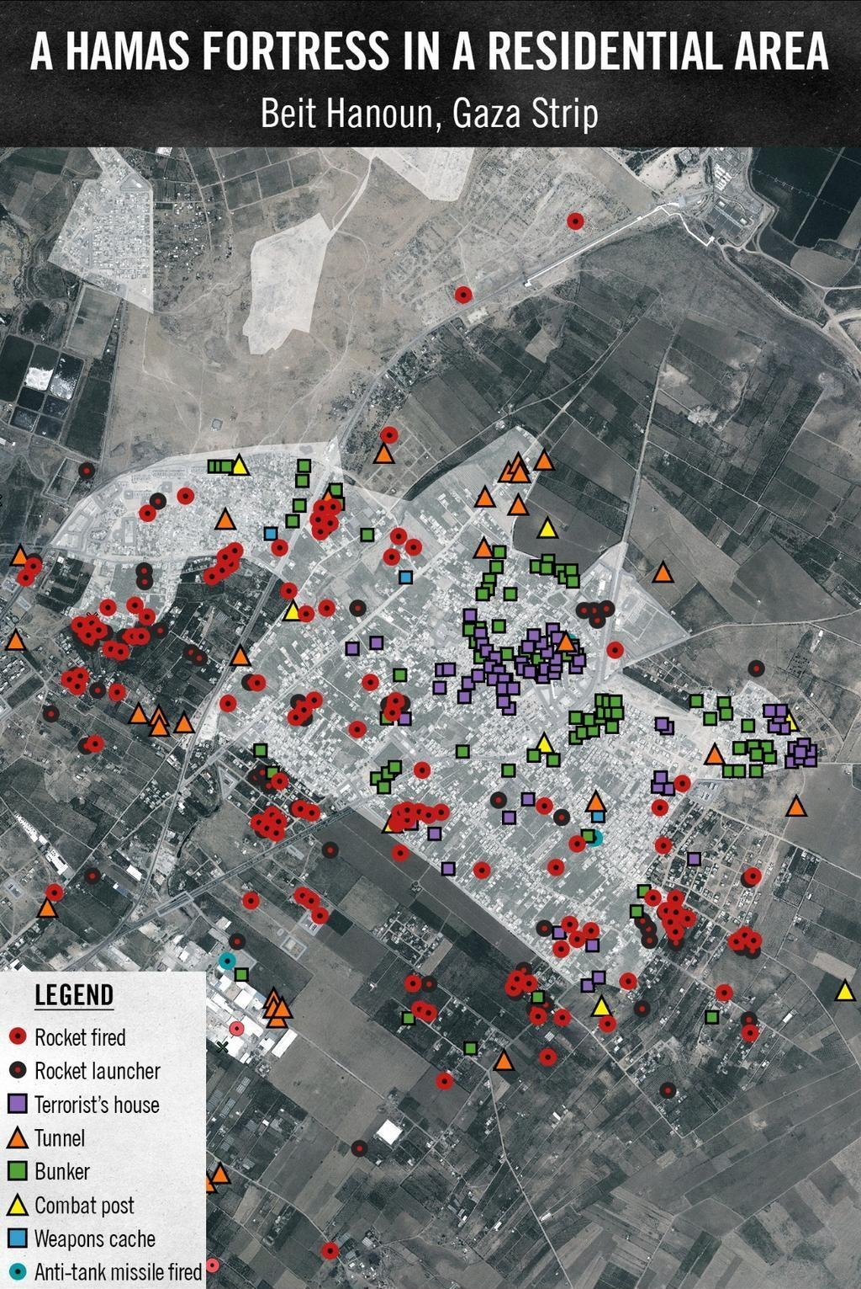
Breakdown of Hamas Terror Fortress in Beit Hanoun

Slide 9
Specific Cases:
Launches from Schools in the Gaza Strip

Slide 10
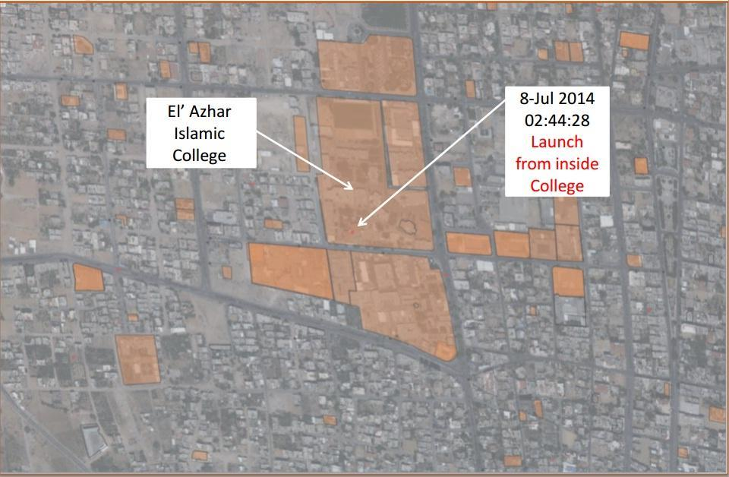
Rocket Launch from Within the El’ Azhar Islamic College

Slide 11
Video: Three Rockets Launched from Abu Nur School

Slide 12
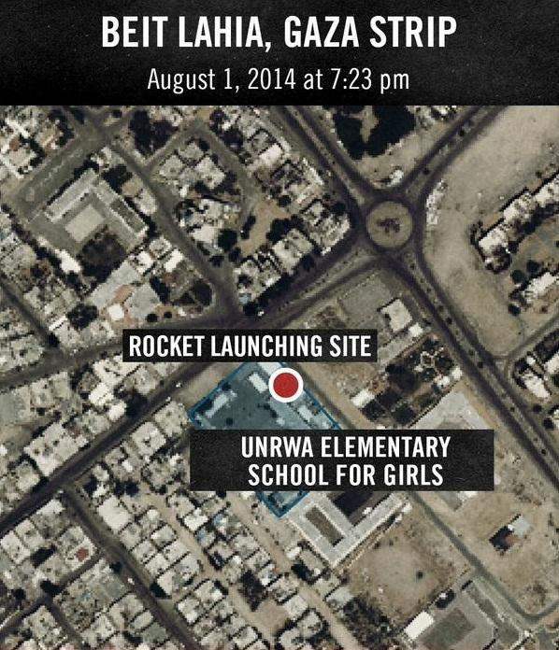
Map of Rocket Launch from an UNWRA School in Beit Lahiya

Slide 13
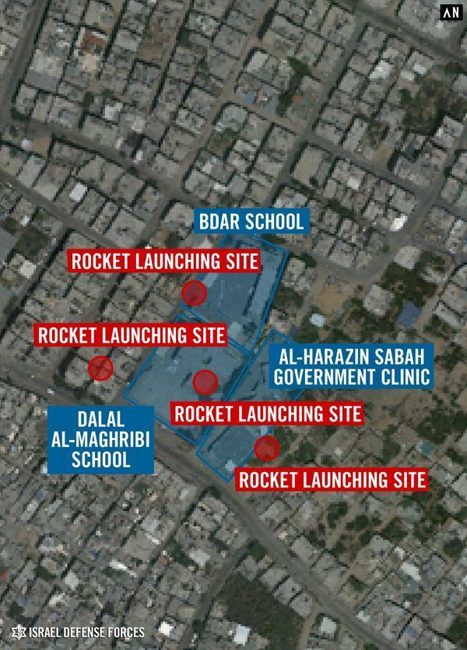
Rocket Launches Near Two Schools in Shuja’iya

Slide 14
Rockets Launched From UN Facilities

Slide 15
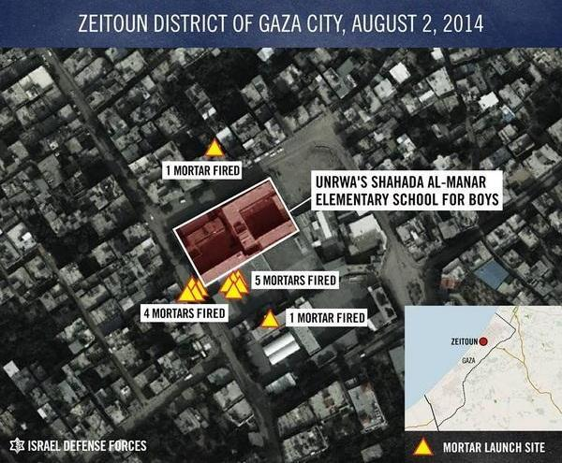
Rocket Launch from an UNWRA Elementary School in Zeitoun District

Slide 16
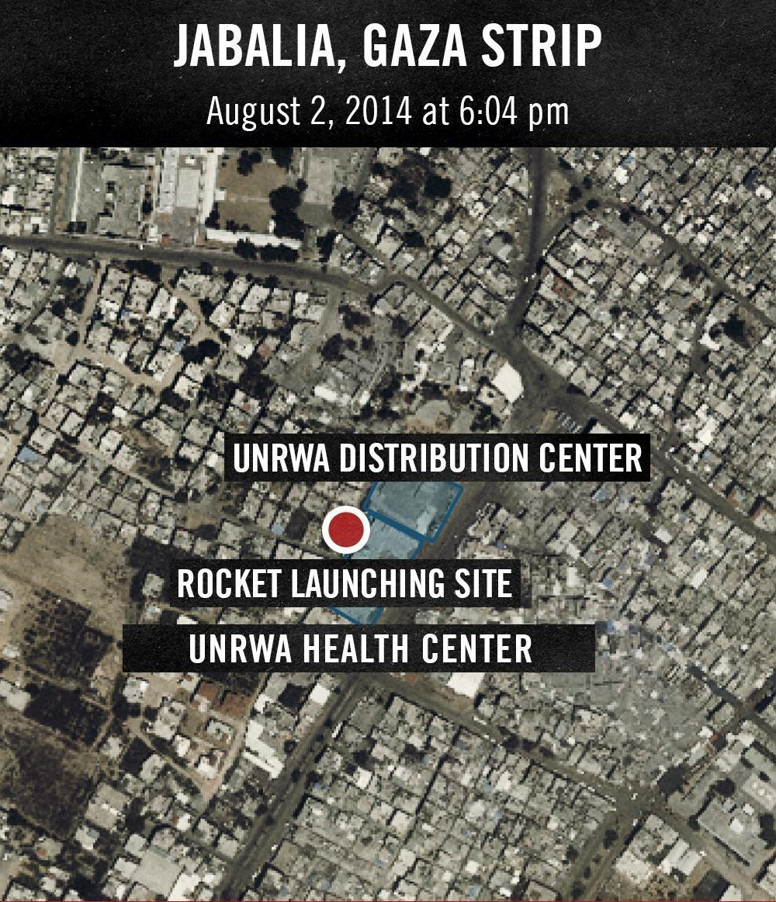
Rocket Launch from an UNWRA Health Center in Jabalia, Gaza

Slide 17
Video: Rockets Launched from UN Facility in Residential Neighborhood

Slide 18
Hamas’ Military Use of Mosques

Slide 19
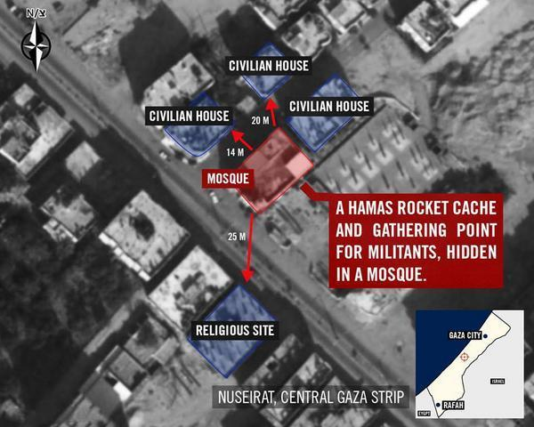
A Mosque Used for Weapons Storage in Nuseirat, Gaza

Slide 20
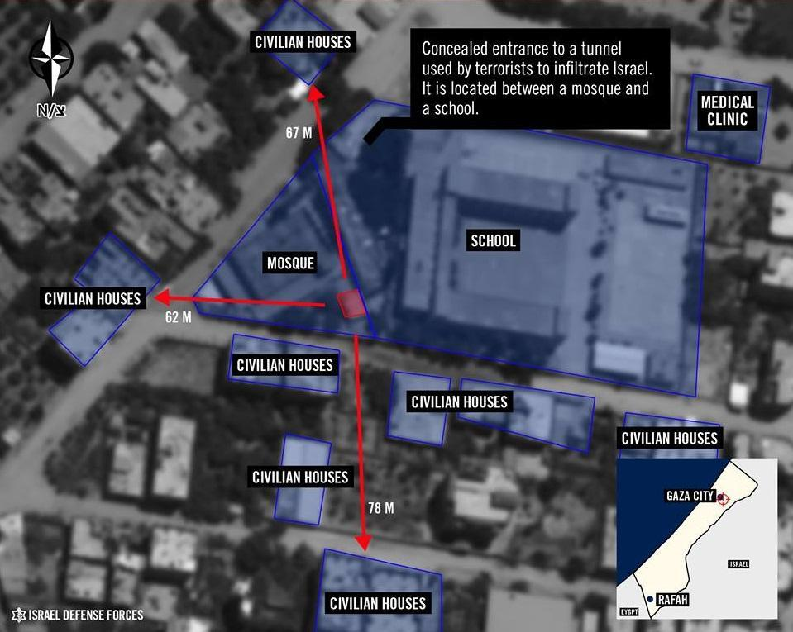
A Mosque in Gaza City Houses a Concealed Entrance to an Attack Tunnel

Slide 21
Video: IDF Finds Weapons Cache and Tunnel Opening in a Mosque

Slide 22
IDF Targets Concealed Rocket Launcher Next to Mosque

Slide 23
Rocket Launches from Medical Facilities

Slide 24
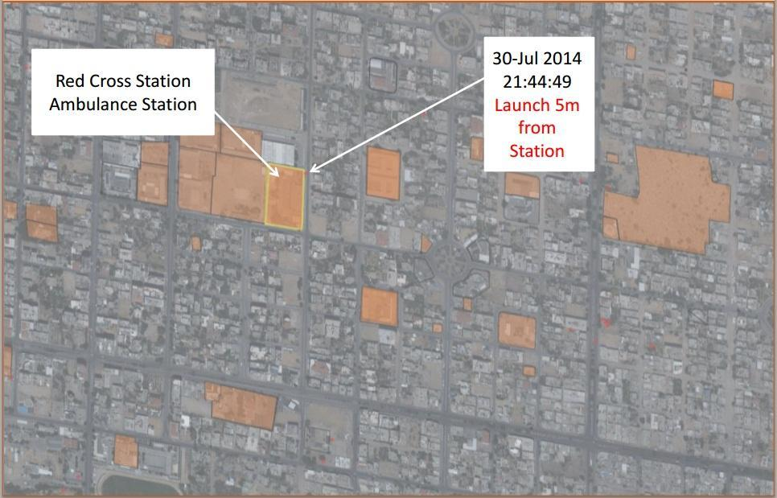
Rocket Launch from a Red Cross Ambulance Station

Slide 25
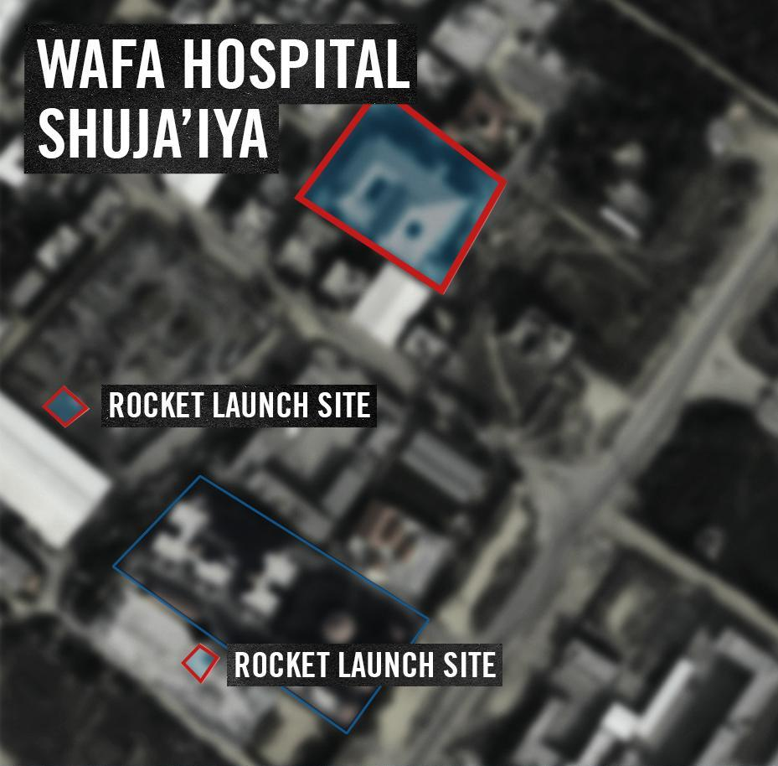
Rocket Launches From Near Wafa Hospital

Slide 26
Rocket Launches from Other Civilian Sites

Slide 27
Video: Rocket Launch From a Cemetery

Slide 28
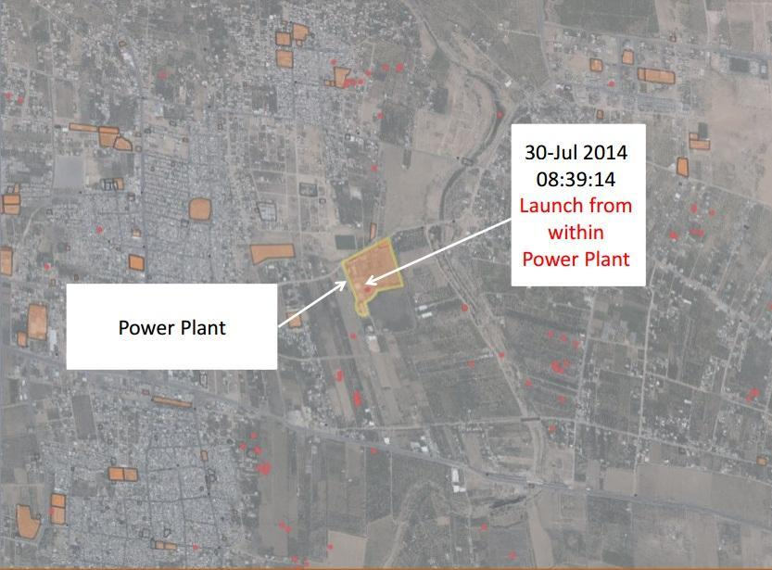
Rocket Launch From a Power Plant

Slide 29
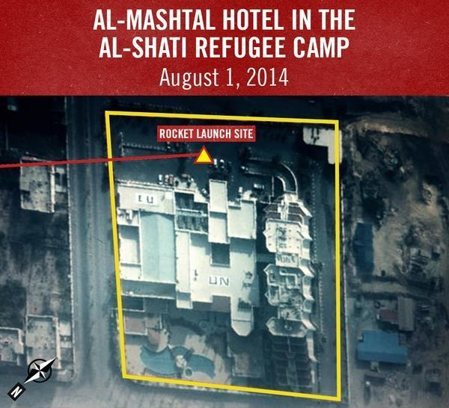
Rocket Launch From a Hotel Where Journalists Were Staying

Slide 30
Video: Hamas Terrorists Prepare and Launch Rockets Beside a Hotel Used by International Media

Slide 31
Other Uses of Civilian Areas by Hamas for Military Purposes

Slide 32
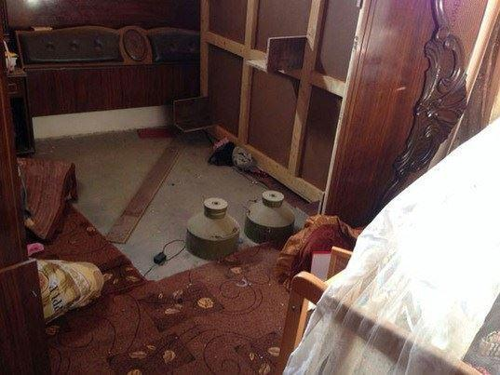
An Example of a Booby-trapped Home

Slide 33
Video: IDF Soldiers Find Homes Rigged with Explosives

Slide 34
Hamas Terrorists Use an Ambulance as a Getaway Vehicle

Slide 35
Conclusion
Hamas’ tactics flagrantly violate international law and the most basic of moral precepts. Given these tactics, the ultimate responsibility for the damage done to civilians as well as the civilian infrastructure of Gaza lies with Hamas.

